Slide 1
Suburban Leisure
Sam, Aisha & Abigail

Slide 2
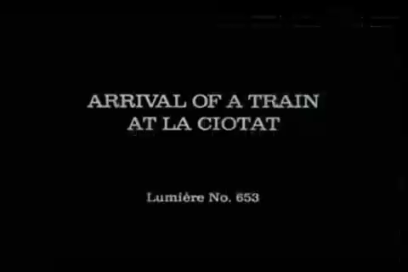
Railroads
Notes:
Parisians and the impressionist spent a lot of their leisure time along the Seine river that was served by the railway the Gare Saint-Lazare (opened in 1837) in which 40% of all Parisian rail passengers passed through.
Since the railways led more consumers to these villages, there was now a thriving market for flowers.
** most of the trains paintings are paired with the river. Juxtaposition of industry and leisure. Also, the beginning of the Saint Lazare started with a line extending over the river. The success of this inspired the building of the Saint-Lazare.

Slide 3
Railroads
Industry goes hand-in-hand with leisure
Westward expansion
Railways advertised themselves in suburbs
Opposition to Railways?
Who built them? Why Does it matter?
Notes:
Westward expansion. (started off with one railroad specifically to aid in Parisian transportation, then popularity of suburbs contributed to railway growth, and commerce follows the crowds and starts to use railways)
Industry went hand-in-hand with leisure
The railways were advertised heavily in suburban areas and offered cheap travel on weekends and holidays.
The villages that we will talk about all had to fight for the Parisian crowds to come to their area, so they expanded festivals and dances to attract them.
Railroads were eager to cooperate with organizers of festivals so they could dampen the opposition to their mutilation of the countryside (like Napoleon throwing entertainment at Paris to distract them from his dictatorship). Favoring tourists over local residents. (Hassmanization)
Industry sprang up: making guides and schedules, and histories, and books that gave artists jobs.
The British built important railways (to connect their colonies in France), they set up factories, and the colonies introduced water sports to Parisians. Segway into who boated and who rowed (class difference).

Slide 4
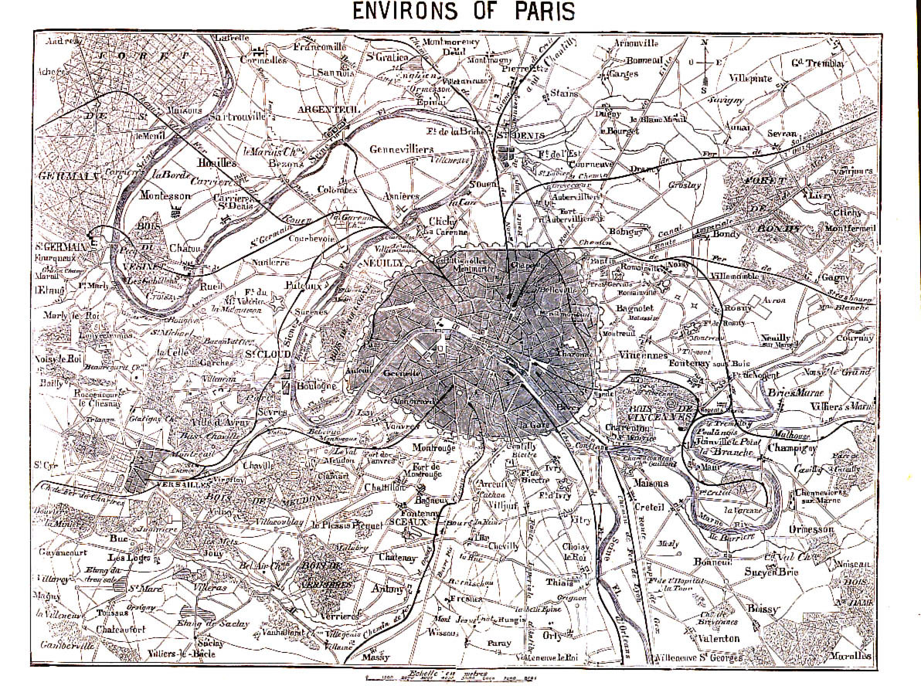
Asnieres
Notes:
Asnieres

Slide 5
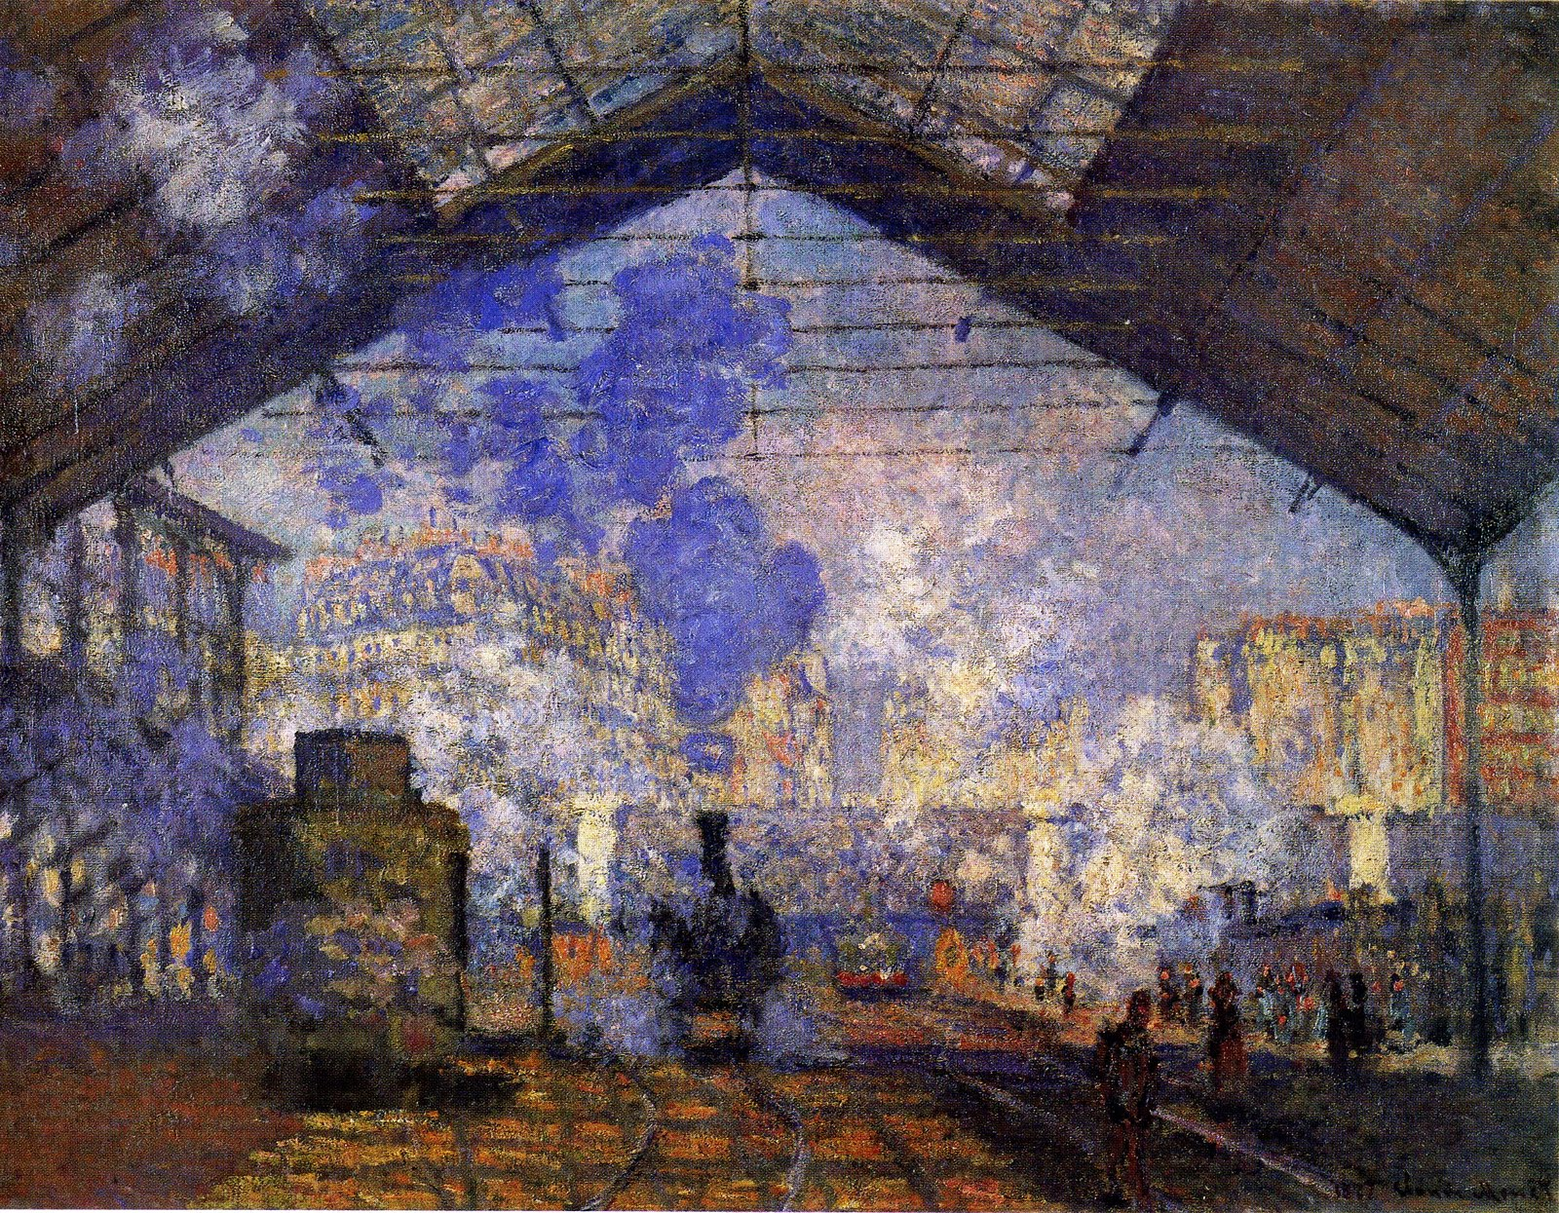
Who: Monet paints from a distance
Why: Huge Sunday Festivals, Popular, First stop off Gare Saint-Lazare
What: Bathing, Rowing, Sailing, Shooting, Riding, Picnicking, Dining, Dancing, Promenading, Concerts, Cafes-concerts, Circuses, Fairs, Produce Markets
Monet, Gare Saint-Lazare 1877
Asnieres
Notes:
1856: Sunday Festivals had 6,000 people in attendance, many ppl used railroad to get there. Asnieres was the first stop, 10 min away from the Gare Saint-Lazare. The rail line advertised Asnieres festivals.
Parisians in Asnieres partook in swimming, rowing, sailing, shooting, riding, picnicking, dining, dancing, promenading, concerts, cafés-concerts, circuses, fairs, and produce markets. All of these were commercialized and provided seasonal jobs.
The convenience of the railway encouraged Parisians to settle in Asnieres, which aided in the villages’ population growth. 1300 in 1856 to 15,200 in 1886.
The rapid growth of the village was also aided in part by the services of many artists who publicized its charms. (Henri Thiery and Adolphe Dupeuty wrote a three-act vaudeville called “Boaters” that honored Asnieres and made songs about boating popular). Many celebrities lived in Asnieres: Theresa, a star of the café-concert, the playwright Armand Silvestre, and journalist Paul Alexis.
Monet lived in Argenteuil, but observed bustling Asnieres.

Slide 6
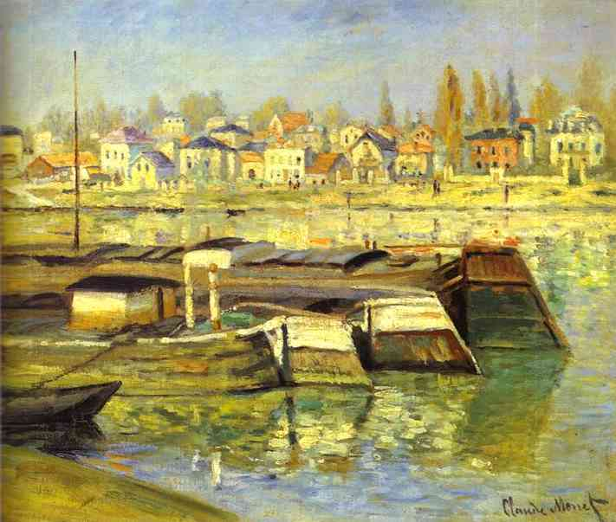
Monet, The Seine at Asnieres 1873
Notes:
Pg. 200

Slide 7
Bougival
Notes:
Bougival

Slide 8
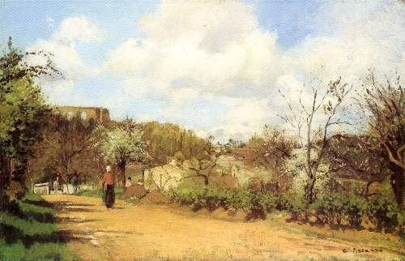
Bougival
Who: Pissarro, Monet, Renoir(?), Morisot(?)
Why: Asnieres is no longer chic, and Bougival offers countryside and history
What: Landscapes/Gardens
picnicing, promenading, bathing, rowing, boating
Pissarro, Springtime at Louveciennes 1868-69
Notes:
The history at Asnieres had been wiped out by the sprouting commerce and business
Artists were active in the transformation of the region: they circulated its charms among Parisians and lived there.
“the homeland and the studio of landscape…”
Middle class vacationers could assert their rights to the privileges of the bygone aristocracy.
Pissarro moved to Louveciennes (a neighboring suburb) 1869-70
Monet moved to Sain-Michel in the heights above Bougival 1869-70
He was joined by Renoir for some months who spent a lot of time in Louveciennes
Morisot visited in 1884 and painted gardens

Slide 9
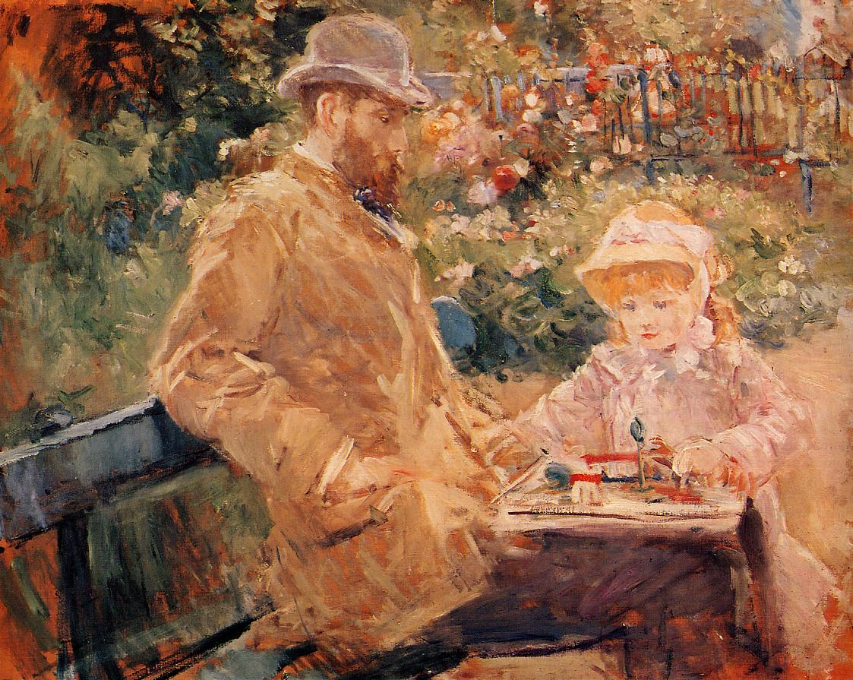
Morisot, Eugene Manet and Daughter at Bougival 1881

Slide 10
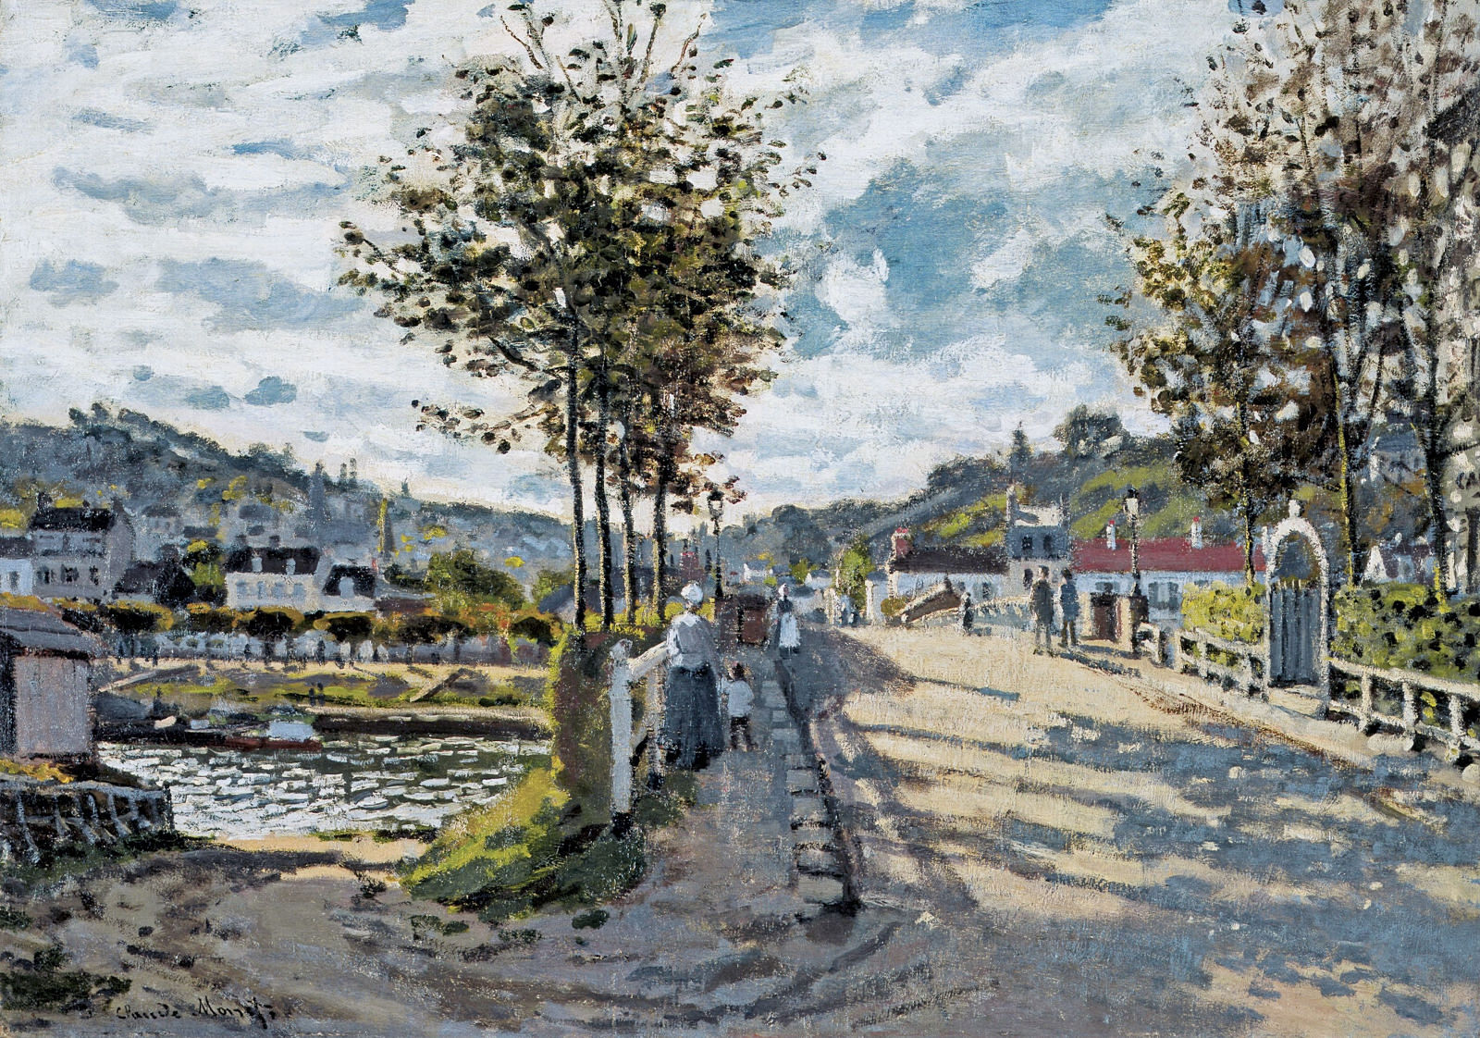
Monet, The Bridge at Bougival 1869

Slide 11
Grenouillere
Notes:
Grenouillere on Croissy Island

Slide 12
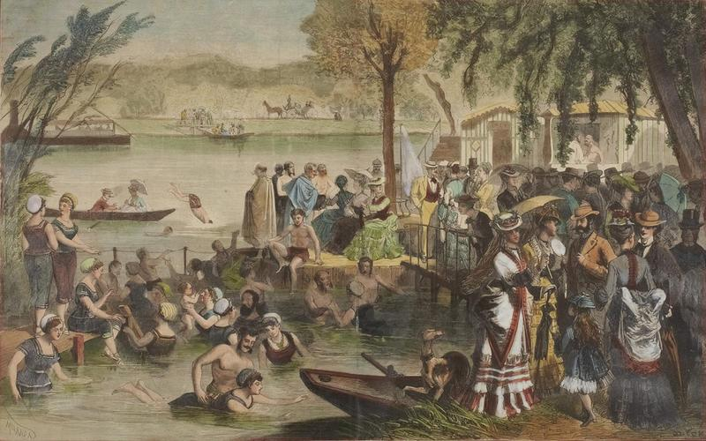
Grenouillere
Who: Monet and Renoir
Why: Croissy Island becomes hugely popular
What: Promenading, Bathing, The Camembert, Boating, Family Outings
Yon, La Grenouillere 1873
Notes:
The noiseiest and most Parisian of the bathing place on Croissy Island.
It was very popular and was even visited by Louis Napoleon in the summer of 1869.
At the time, Monet was trying to get into the Salon, and because of Genouilere’s popularity, it seemed like a promising subject.
“The country near Chatou, Croissy, and Bougival is inhabited by a swarm of writers, men and women belonging to the artic life of Paris. The have a habit of finding one another along the banks…” quote by Chapus
Monet and Renoir were among the artists that found each other along the banks and they collaborated together, painting many impressionist works.
Yon’s La Grenouillere (above) showcases the elements of Grenouillere that Monet and Renoir will paint: promenading, bathing/swimming, the Camembert (small island), floating dining boats, boating, family life (child and dog).

Slide 13
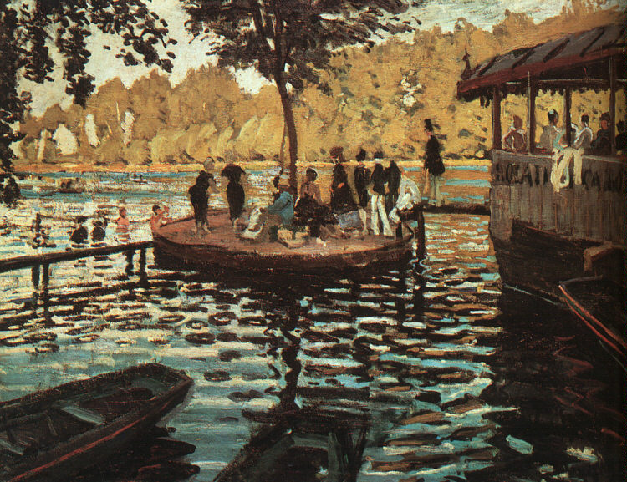
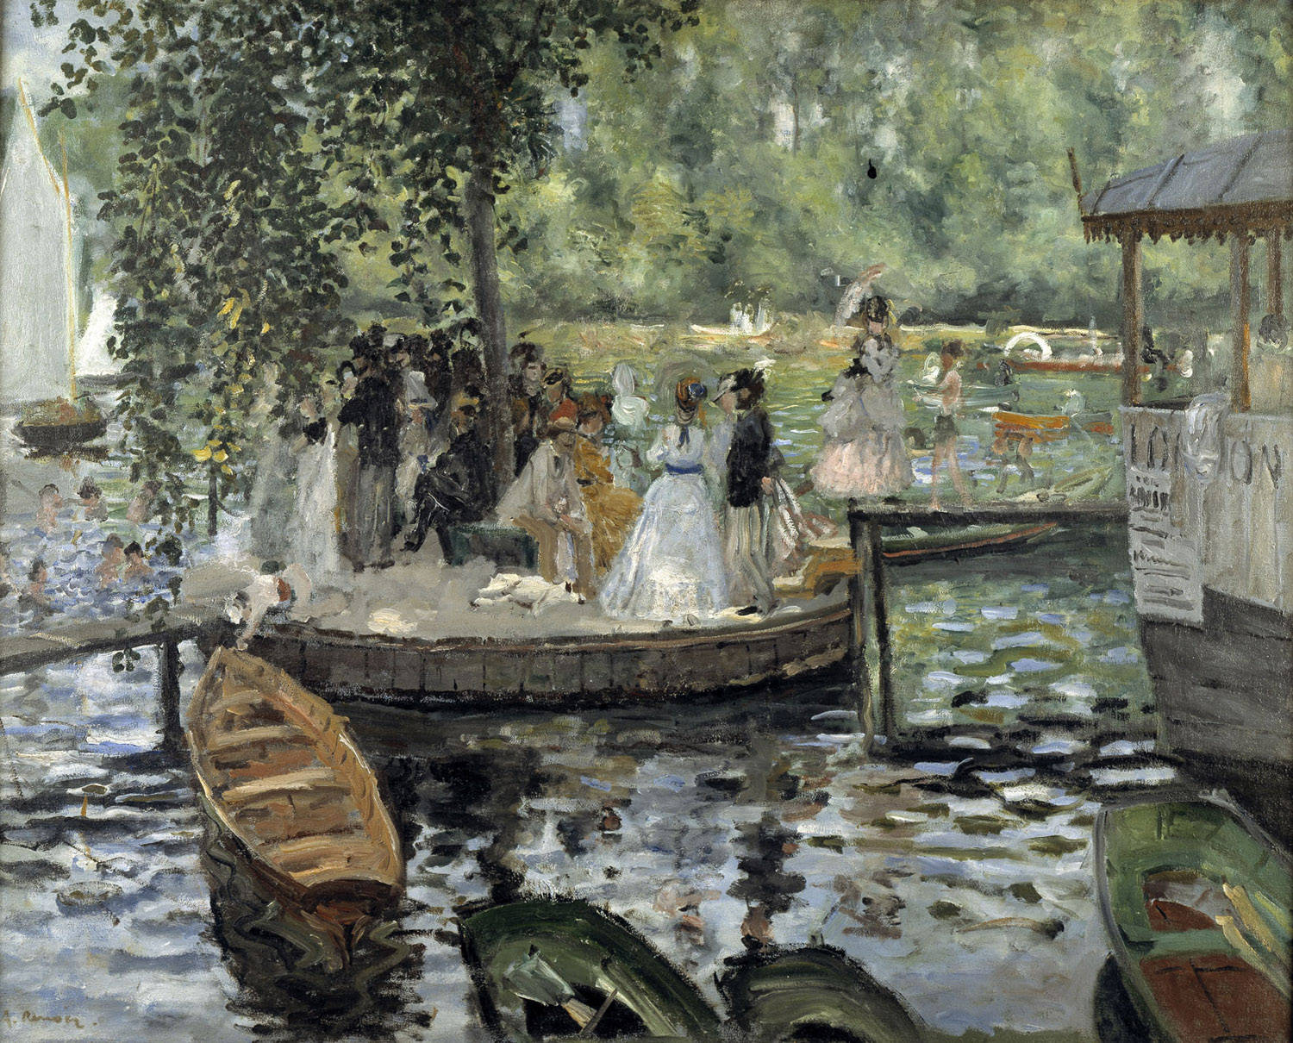
Monet, La Grenouillere 1869
Renoir, La Grenouillere 1869
Notes:
Monet and Renoir, La Grenouillere
1869
The first impressionist works?

Slide 14
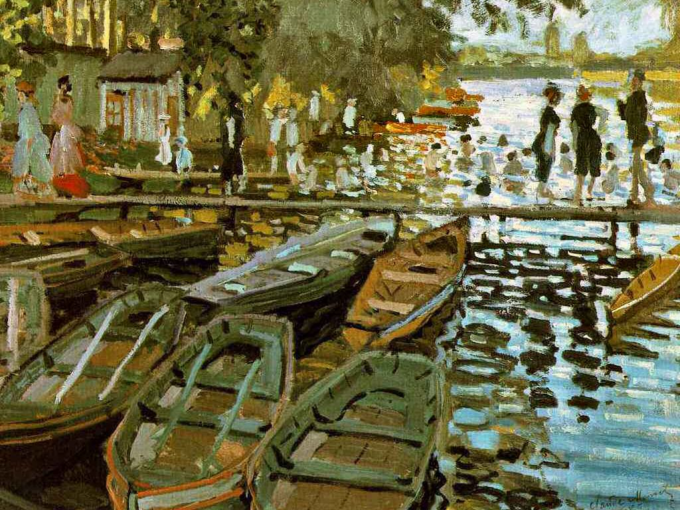
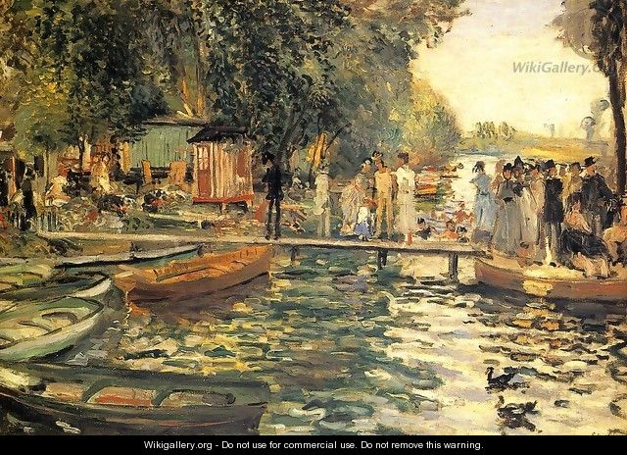
Monet, Bathing at la Grenouillere 1869
Renoir, La Grenouillere 1869
Notes:
Monet, Bathing at la Grenouillere
Renoir, La Grenouillere
1869

Slide 15
Argenteuil
Notes:
Argenteuil

Slide 16
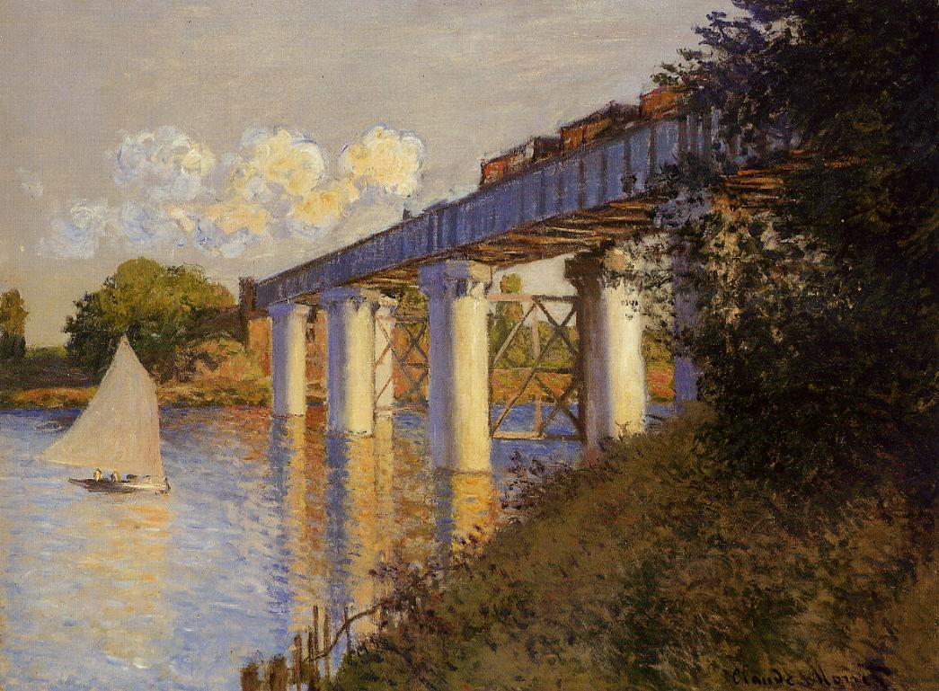
Argenteuil
Who: Monet lives here. Renoir, Manet (?)
Why: Winds for sailing. More modern.
What: Sailing
Monet, The Railroad Bridge at Argenteuil 1874
Notes:
Aisha
Gardens (Monet at Argenteuil and then contrasted with Monet Giverny Water Lilies)
Trains/bridges: Monet, The Railroad Bridge, Argenteuil

Slide 17
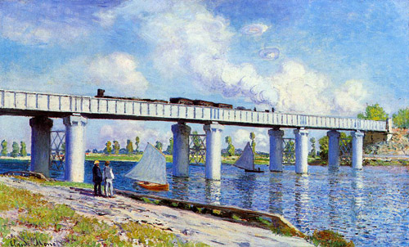
Monet, The Railroad Bridge, Argenteuil 1873

Slide 18
Monet, Sailboats at Argenteuil 1874
Renoir, Sailboats at Argenteuil 1874

Slide 19
Manet, Monet Painting in his Studio Boat 1874

Slide 20
Monet, The Promenade 1872

Slide 21
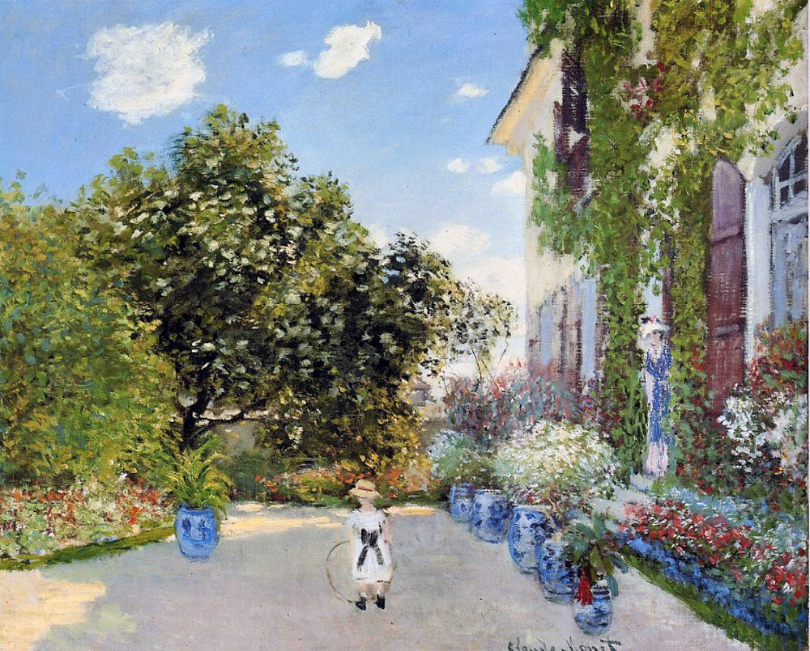
Monet, Monet’s House at Argenteuil 1873

Slide 22
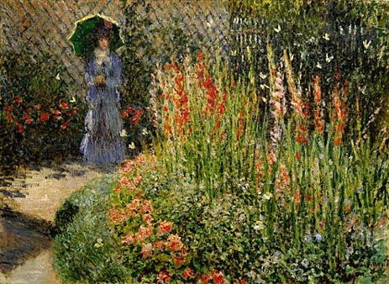
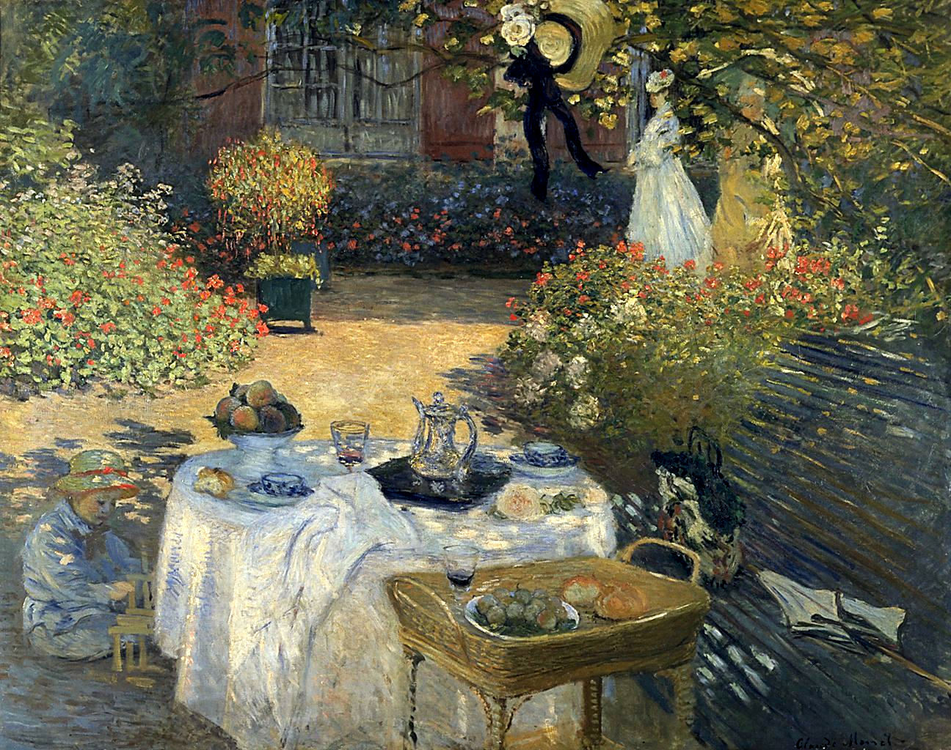
Monet, Gladioli 1876
Monet, The Luncheon 1874

Slide 23
Versailles
Notes:
Garden Map:
Versailles (left arrow)

Slide 24
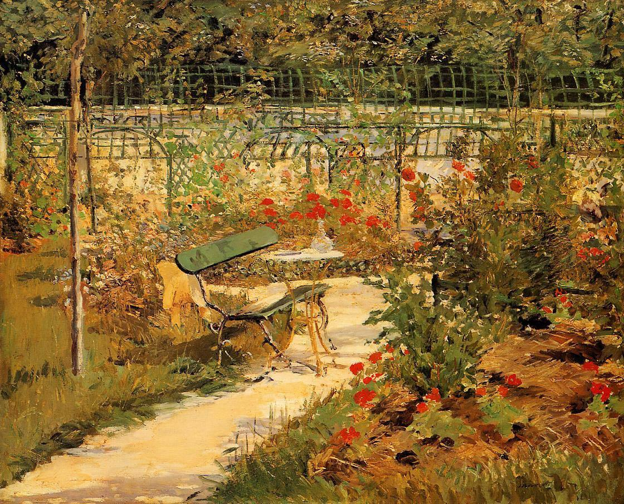
Manet, The Bench 1881
Notes:
Versailles

Slide 25
Chatou
Notes:
Chatou

Slide 26
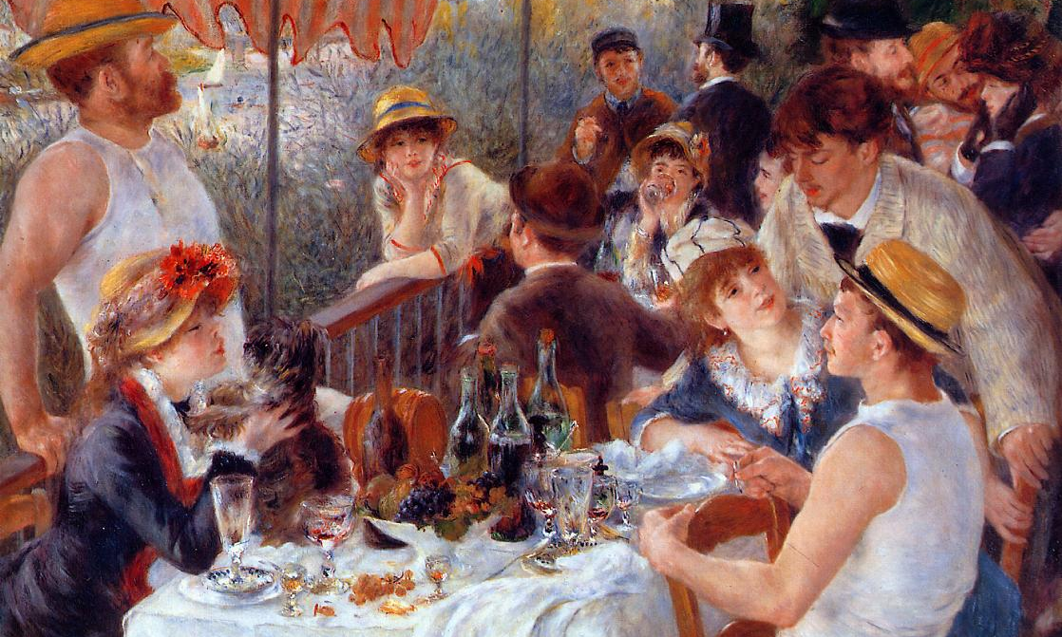
Chatou
Who: Caillebotte, Renoir
Why: Close to Argenteuil, but with no wind, and only 9 miles south of Gare Saint-Lazare.
What: Rowing.
Renior, Luncheon of the Boating Party 1881

Slide 27
Caillbotte, Oarsmen in a hat 1877
Caillbotte, Oarsmen 1877

Slide 28
Renoir, The Canoeist Luncheon 1879

Slide 29
FIN

